Slide 1
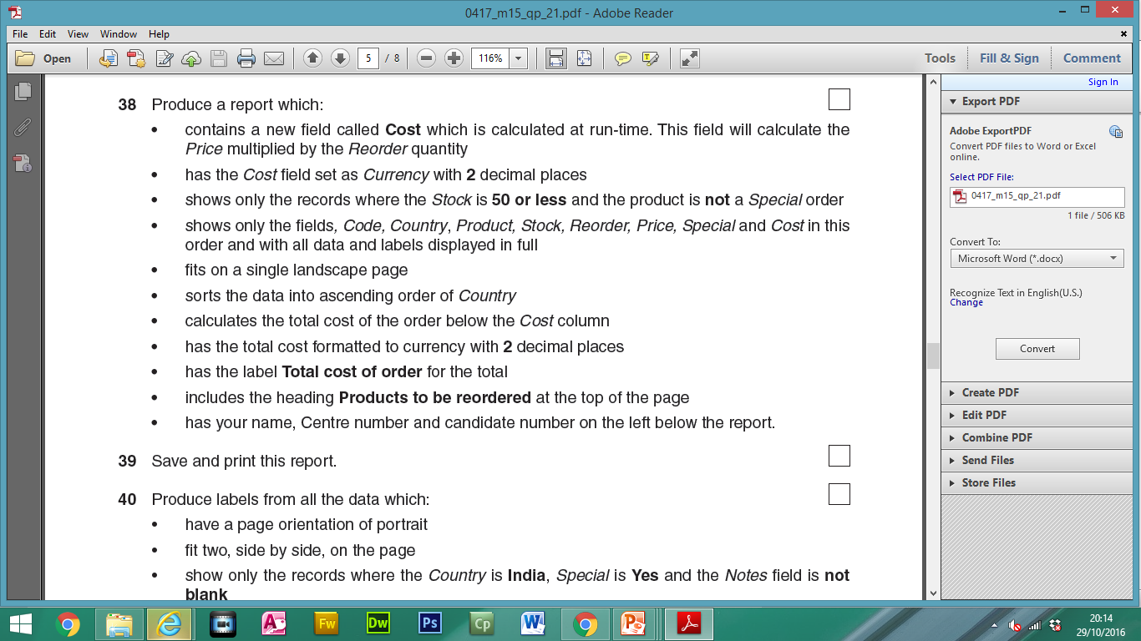
Calculated Field:
Y/N
Search Criteria

Slide 2
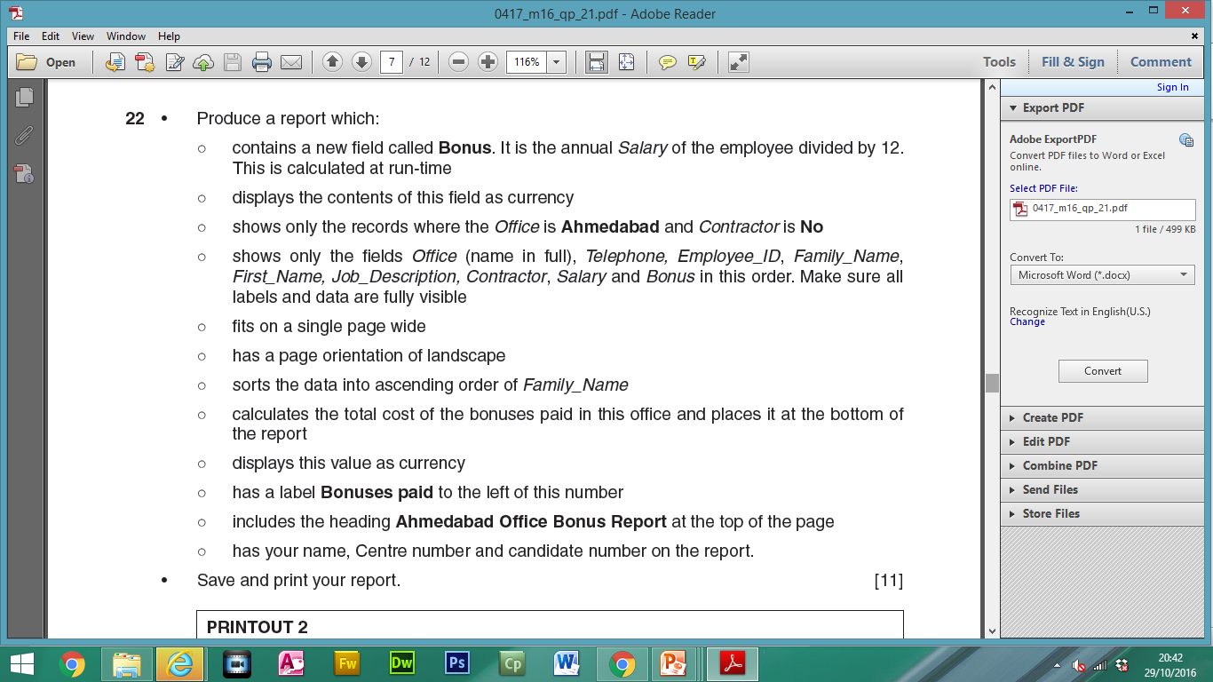
Calculated Field:
Search Criteria

Slide 3
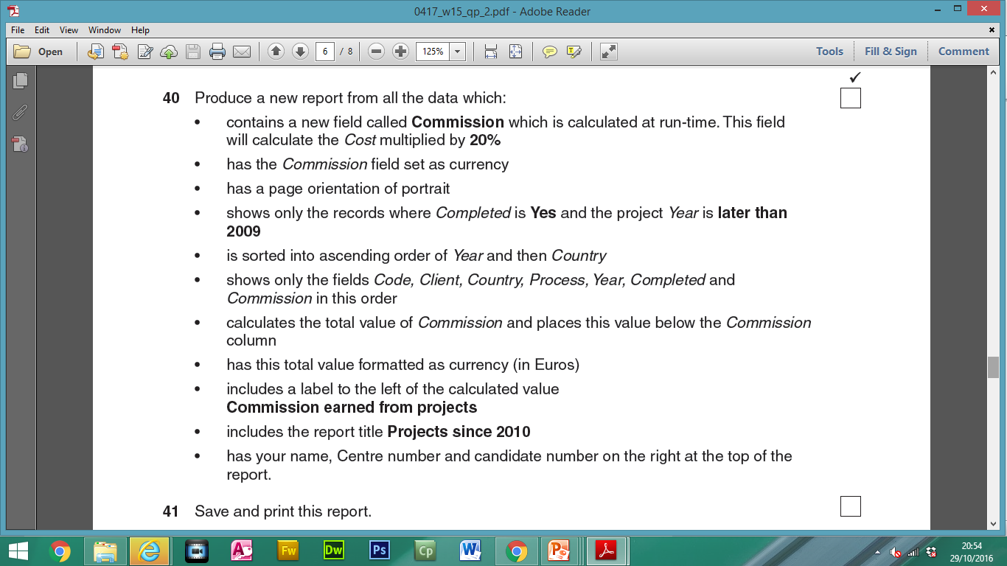
Calculated Field:
Search Criteria

